Slide 1
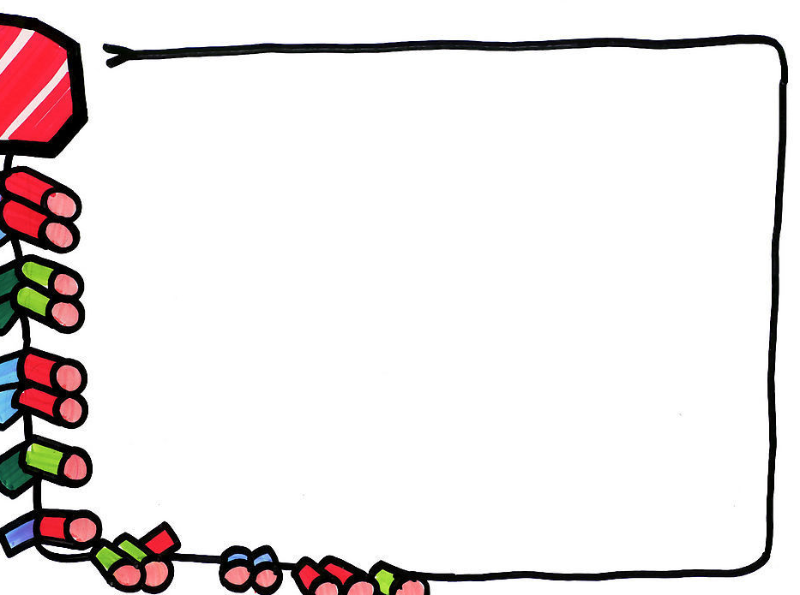
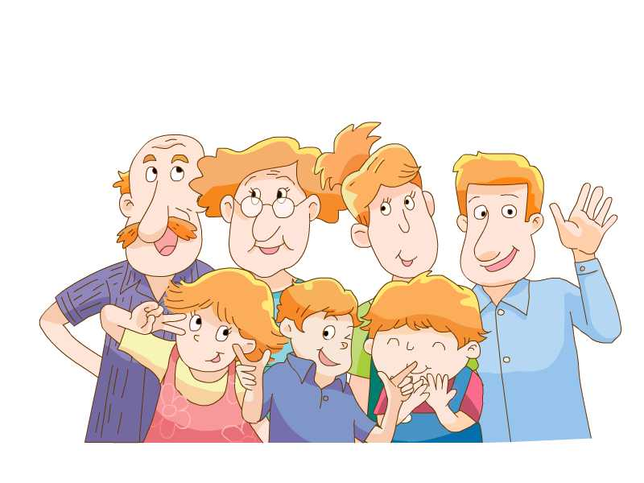
Unit4 My family
Story time

Slide 2
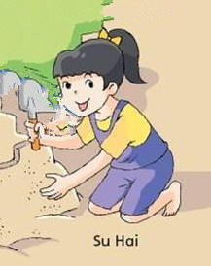
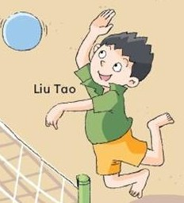
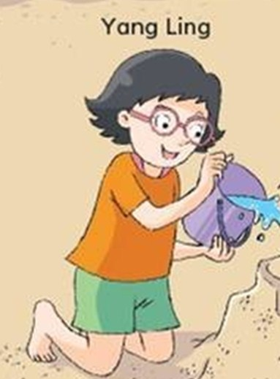
Magic eyes
Who’s he/she?
He’s …
She’s …

Slide 3
Magic eyes
Who’s he/she?
Bobby
He’s …
She’s …
Tina

Slide 4
Bobby,who’s she?
Bobby，把她介绍给大家.
This is … .She’s my …
Tina
sister.
Bobby
Tina

Slide 5
Tina, who’s he?
This is Bobby.
He’s my brother.
Bobby
Tina

Slide 6
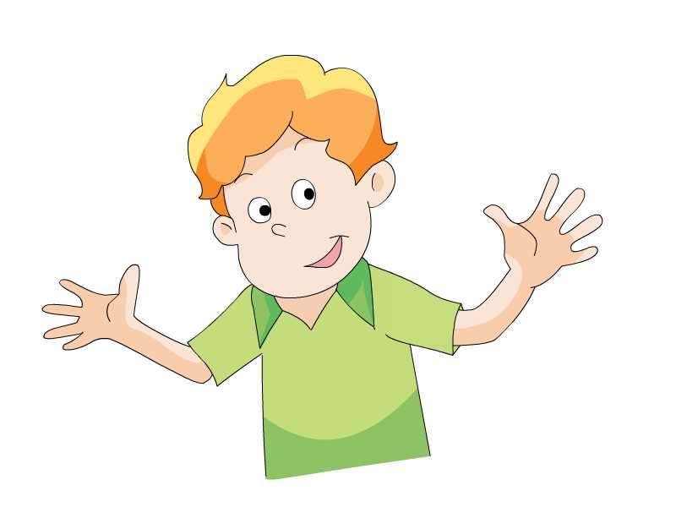
Story time
Mike also has a brother. Who is he?
迈克也有个兄弟。他是谁？

Slide 7
Story time
This is Tim.
He’s my brother.

Slide 8
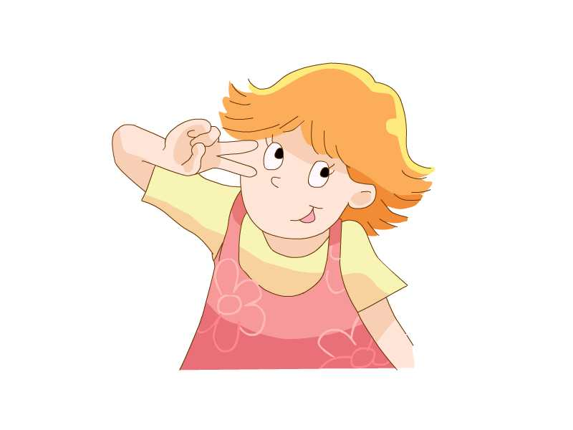
Story time
This is Helen.
She’s my sister.

Slide 9
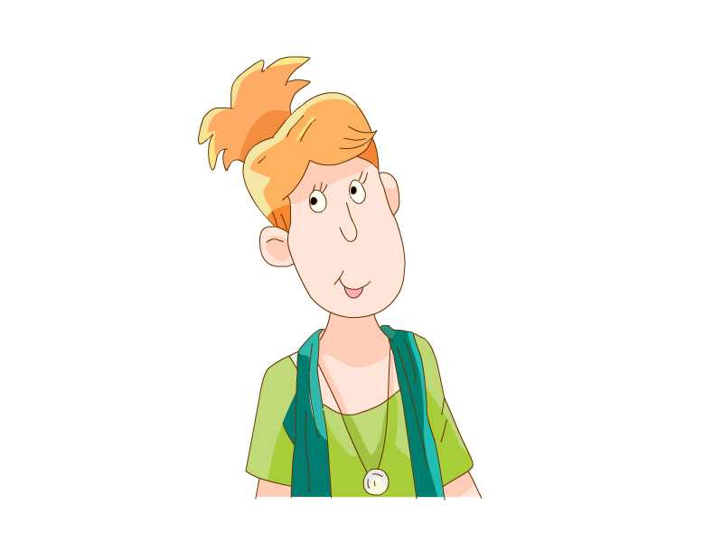
Story time
This is my father.
This is my mother.

Slide 10
Read the new words
father
mother
brother
sister

Slide 11
Listen and answer
听故事，回答问题。
How many people are there
in the story?故事里有几个人？
A. 4.
B. 5
√
This is a big family.
这是一个大家庭。

Slide 12
这是我的家庭。
This is my family.

Slide 13
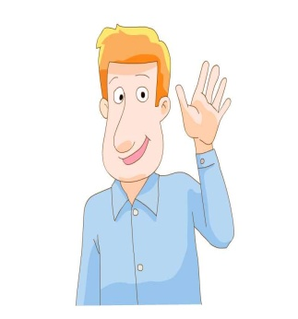
Read and match
D.This is my father.
C.This is my mother.
B.This is Helen.
She’s my sister.
A.This is Tim.
He’s my brother.
A.This is Tim.
He’s my brother.
E. This is me.
B.This is Helen.
She’s my sister.
C.This is my mother.
D.This is my father.
E. This is me.

Slide 14
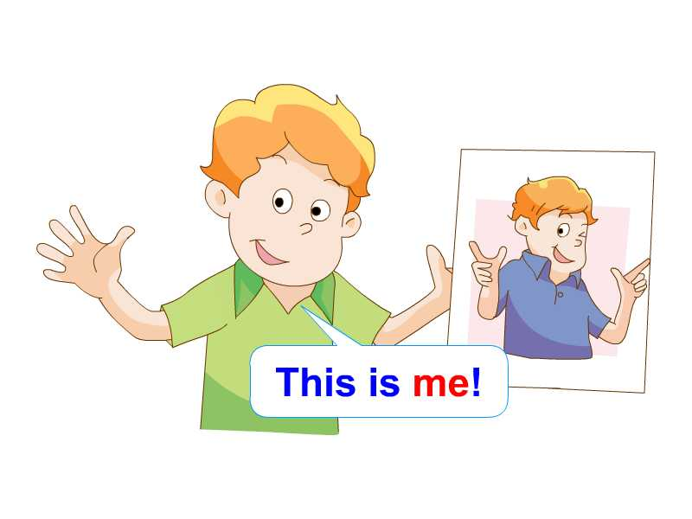

Slide 15
f
a
m
i
l
y
Father and mother, I love you.

Slide 16
Chant
Father, father,
this is my father.
Mother, mother,
this is my mother.
Sister, sister,
this is my sister.
Brother, brother,
this is my brother.
We all live together.

Slide 17
Show time
如果你是Mike，请你向大家介绍一下你的家人。
This is my family.
This is my …
This is me.
father
mother
Tim
Helen
brother
sister

Slide 18
Homework
1. Retell the story.复述故事。
2. Prepare a photo of your family.
准备一张家庭照。

